Slide 1
A Text Image Segmentation Algorithm Based on Spectral Clustering: A Survey
Student: Phan Thi My Dung

Slide 2
Outline
Introduction
Text Image Segmentation using Normalized Cut
Experimental Result
Conclusion and Future work
Reference

Slide 3



Introduction
Text segmentation is a precursor to text retrieval, information retrieval (IR), language modeling (LM), OCR System …
Natural scene image: street name, signal boards, …

Slide 4
Related Work
In Pan’s (2007,pp.412-416), a simple global threshold achieved by using Otsu’s (Otsu,1979,pp.62-66) thresholding technique
Lienhart (2002,pp.256-268) performed the binarization using the intensity value halfway between the intensity of the text colors and the background color as a threshold.
Wu (1999,pp.1224-1229) proposed a simple histogram-based algorithm to automatically find the threshold value for each text region, making the text segmentation process more efficient.

Slide 5
Proposed Method
Problem: Segment text in natural scene images
Solution:
Assume the text have been detected in the image.
Using the normalized graph cut to segment image and extract the text.
The measure for spectral clustering is the affinities (similarities) between groups of pixel that have the same grayscale level.

Slide 6
Text Image Segmentation using Normalized Cut
Given an image, we can construct a histogram-based matrix M by computing the all weights of nodes in the corresponding graph.
Let M be the affinity matrix, we can get a complete approach of image segmentation using spectral clustering

Slide 7
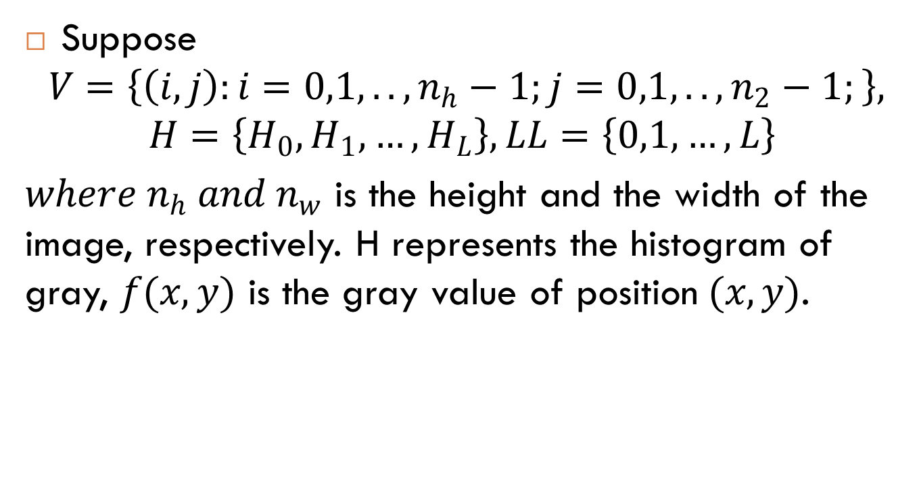
Text Image Segmentation using Normalized Cut - Steps
Suppose
$$V=\left\{\left(i,j\right):i=0,1,..,n_{h}−1;j=0,1,..,n_{2}−1;\right\},$$
$$H=\left\{H_{0},H_{1},…,H_{L}\right\}, LL=\left\{0,1,…,L\right\}$$
$where n_{h} and n_{w}$ is the height and the width of the image, respectively. H represents the histogram of gray, $f(x,y)$ is the gray value of position$(x,y)$.

Slide 8
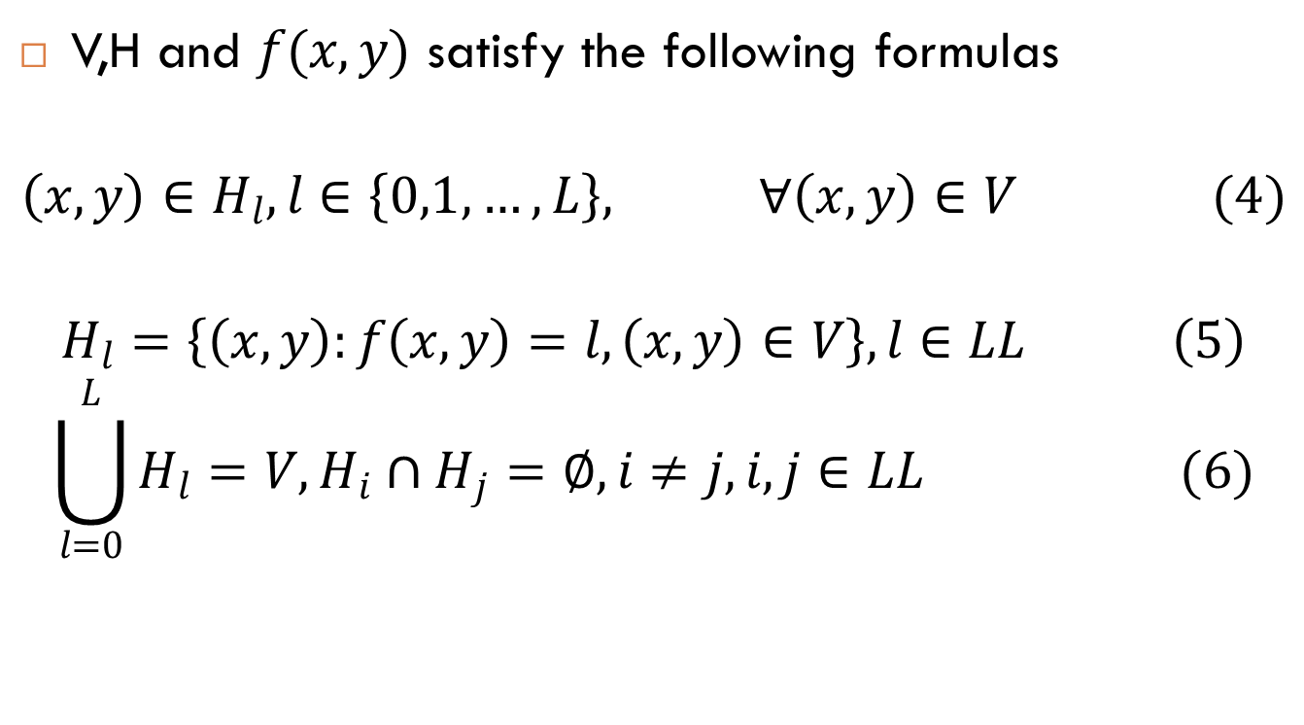
Text Image Segmentation using Normalized Cut - Steps
V,H and $f(x,y)$ satisfy the following formulas
$$\left(x,y\right)∈H_{l}, l∈\left\{0,1,…,L\right\}, ∀\left(x,y\right)∈V (4)$$
$$H_{l}=\left\{\left(x,y\right):f\left(x,y\right)=l,\left(x,y\right)∈V\right\}, l∈LL \left(5\right)$$
$$\bigcup_{l=0}^{L}{H_{l}}=V, H_{i}∩H_{j}=∅,i≠j,i,j∈LL (6)$$

Slide 9
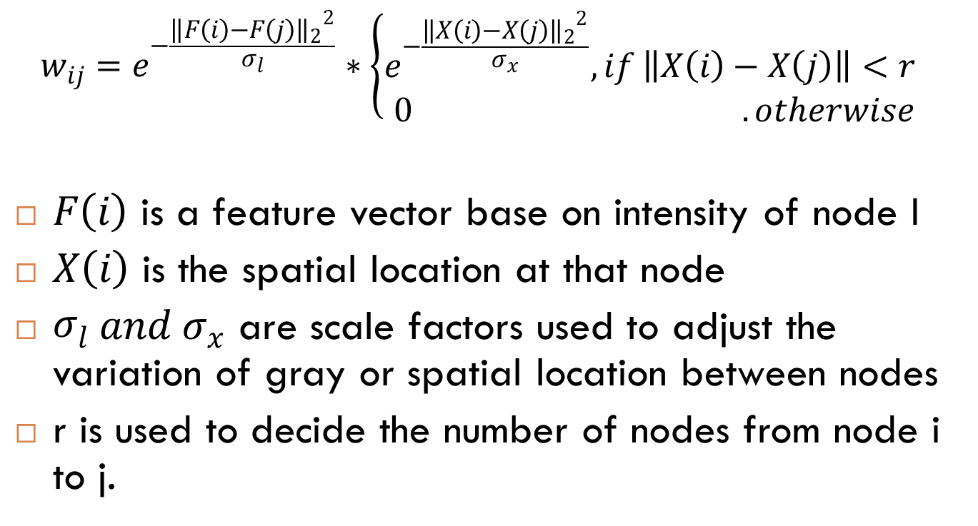
Weight Matrix for images
$$w_{ij}=e^{−\frac{{{\left\|F\left(i\right)−F\left(j\right)\right\|}_{2}}^{2}}{σ_{l}}}∗\left\{\begin{matrix}e^{−\frac{{{\left\|X\left(i\right)−X\left(j\right)\right\|}_{2}}^{2}}{σ_{x}}}, if \left\|X\left(i\right)−X\left(j\right)\right\|<r \\ 0 . otherwise\end{matrix}\right.$$
$F\left(i\right)$ is a feature vector base on intensity of node I
$X\left(i\right)$ is the spatial location at that node
${\begin{aligned}σ\end{aligned}}_{l} and σ_{x}$ are scale factors used to adjust the variation of gray or spatial location between nodes
r is used to decide the number of nodes from node i to j.

Slide 10
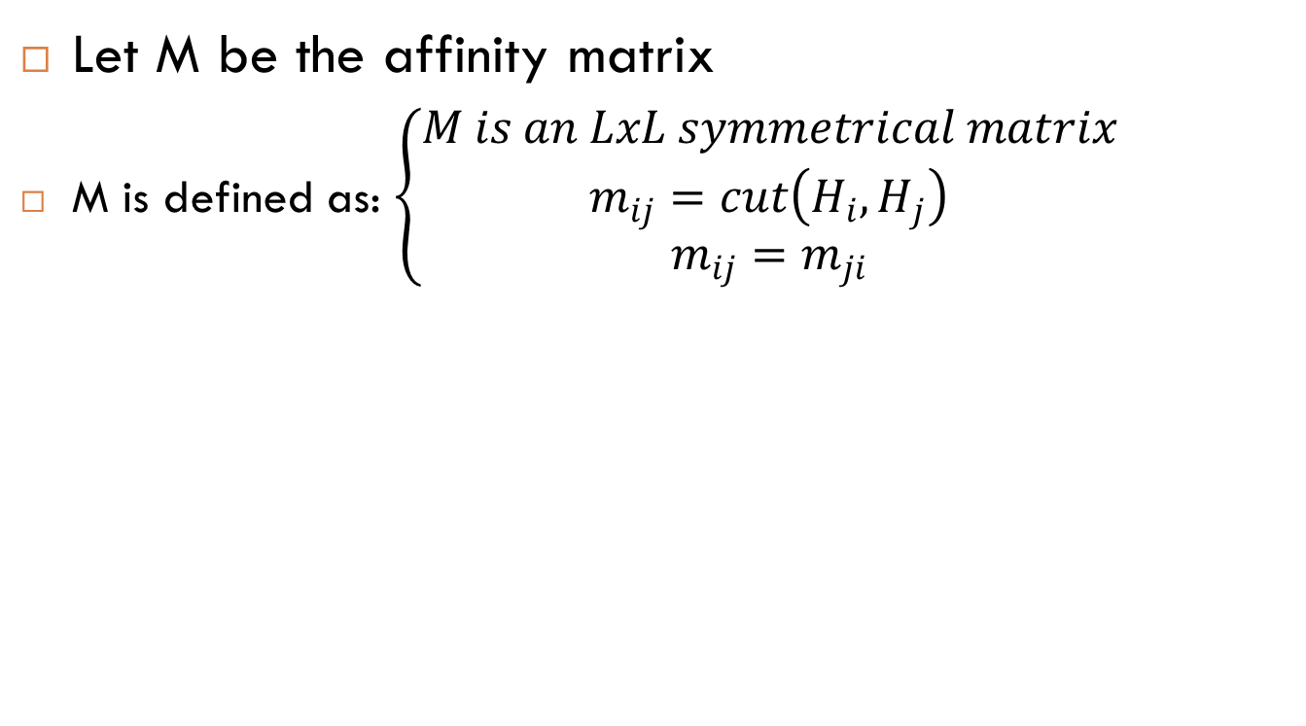
Histogram based matrix M
Let M be the affinity matrix
M is defined as: $\left\{\begin{matrix}M is an LxL symmetrical matrix \\ m_{ij}=cut\left(H_{i},H_{j}\right) \\ m_{ij}=m_{ji}\end{matrix}\right.$

Slide 11
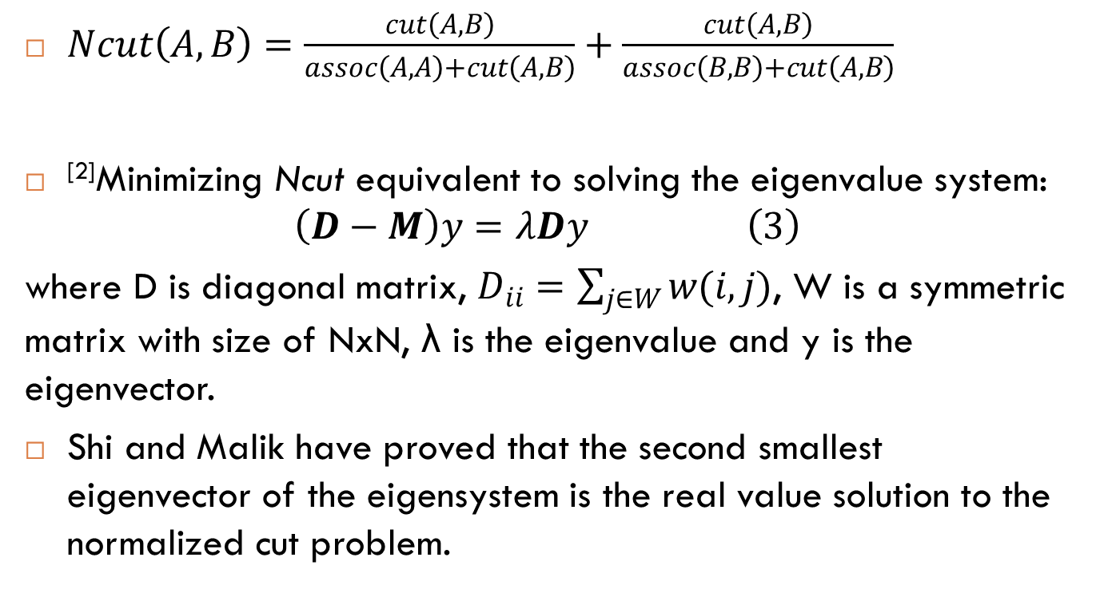
Bipartition the graph
$Ncut\left(A,B\right)=\frac{cut\left(A,B\right)}{assoc\left(A,A\right)+cut\left(A,B\right)}+\frac{cut\left(A,B\right)}{assoc\left(B,B\right)+cut\left(A,B\right)}$
^{[2]}Minimizing Ncut equivalent to solving the eigenvalue system:
$$\left(D−M\right)y=λDy \left(3\right)$$
where D is diagonal matrix, $D_{ii}=\sum_{j∈W}{w(i,j)}$, W is a symmetric matrix with size of NxN, λ is the eigenvalue and y is the eigenvector.
Shi and Malik have proved that the second smallest eigenvector of the eigensystem is the real value solution to the normalized cut problem.

Slide 12
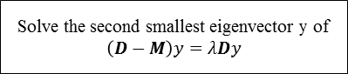
Workflow
Construct the weighted graph G=(V,E) and the affinity matrix M based on histogram of grayscale
Compute the diagonal matrix D of M
Solve the second smallest eigenvector y of $\left(D−M\right)y=λDy$
Use the eigenvector with the second smallest eigenvalue to bipartition the graph
Recursive partition the segmentation
if nCut < maxCutValue

Slide 13
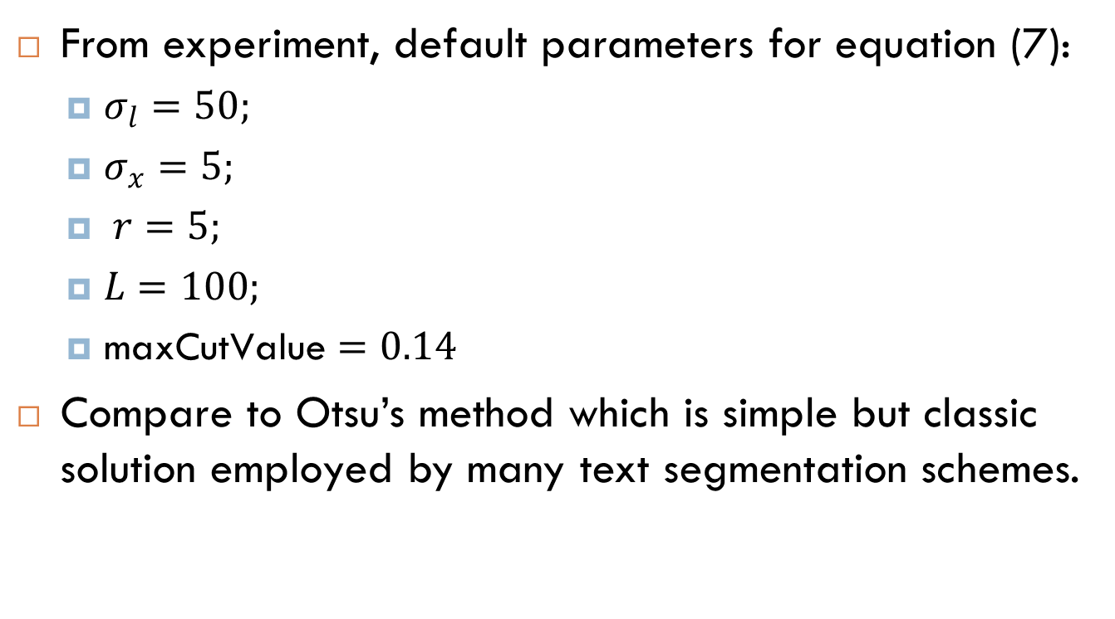
Experimental Result
From experiment, default parameters for equation (7):
$σ_{l}=50;$
$σ_{x}=5;$
$r=5;$
$L=100;$
$\text{maxCutValue}=0.14$
Compare to Otsu’s method which is simple but classic solution employed by many text segmentation schemes.

Slide 14

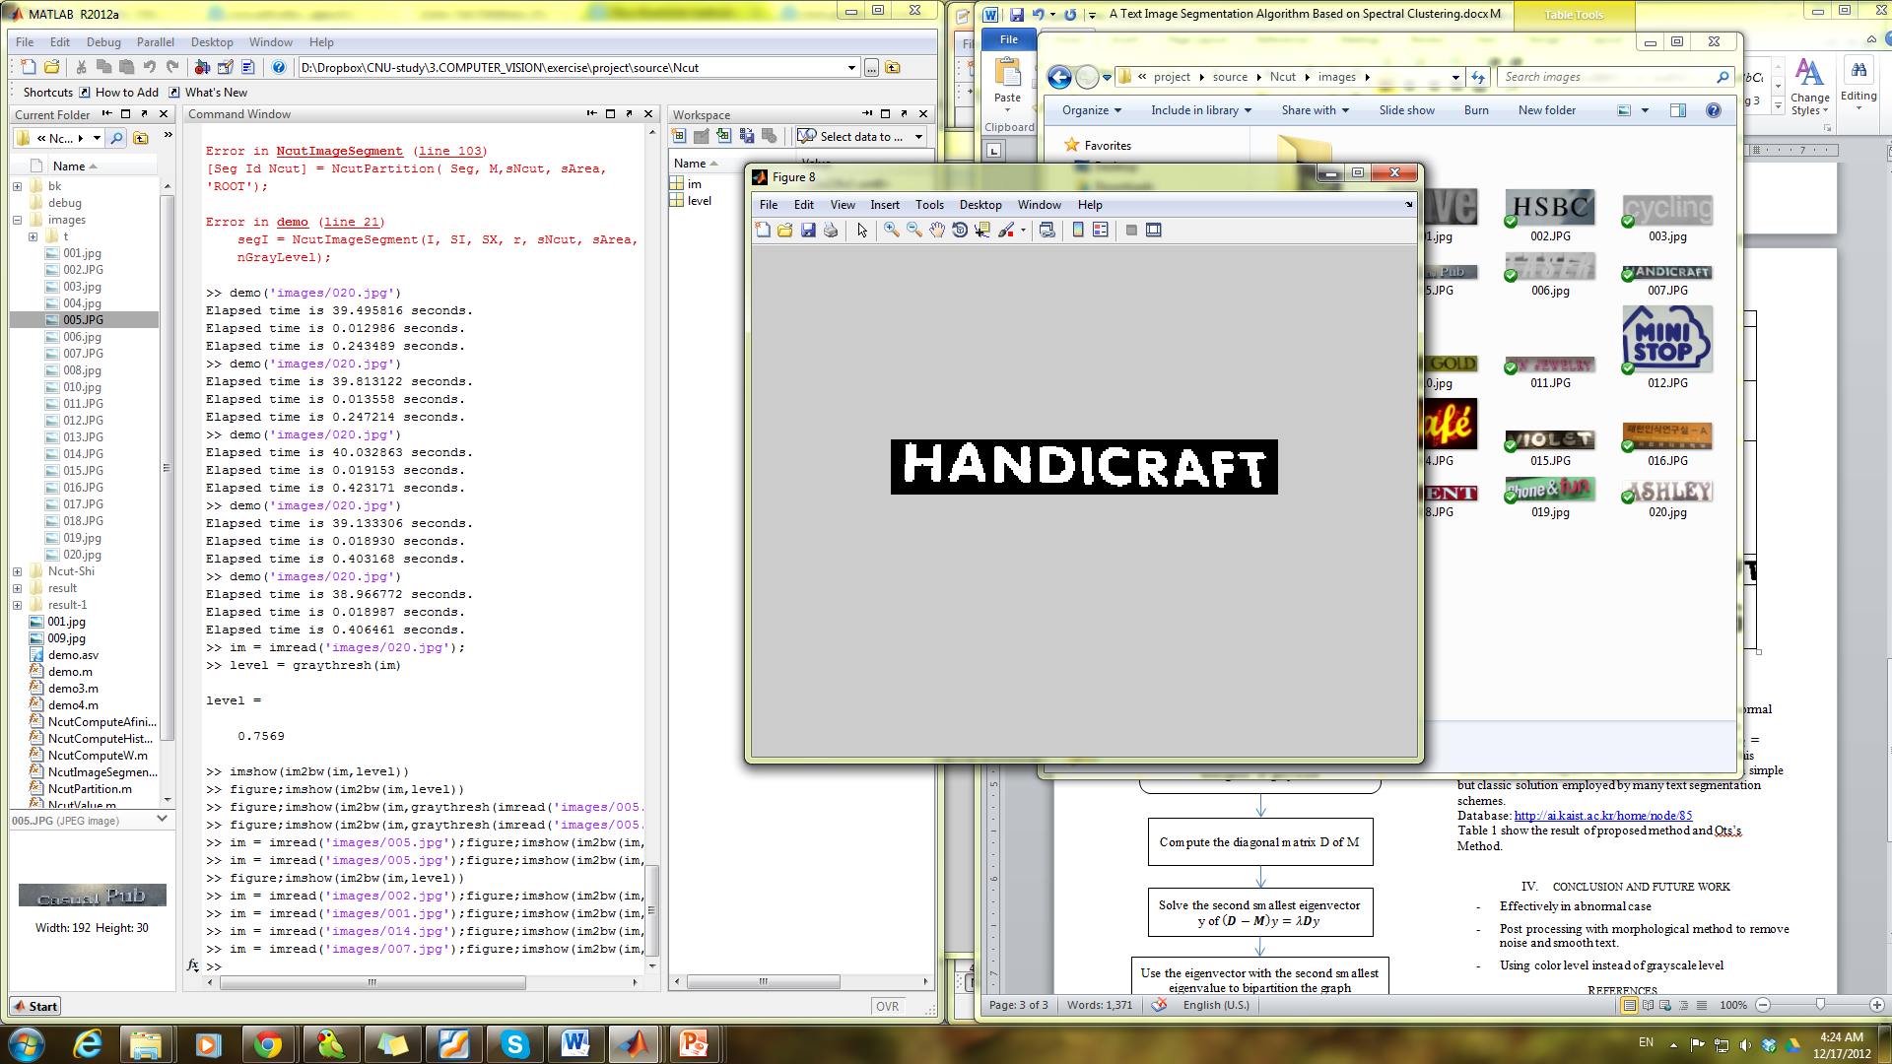





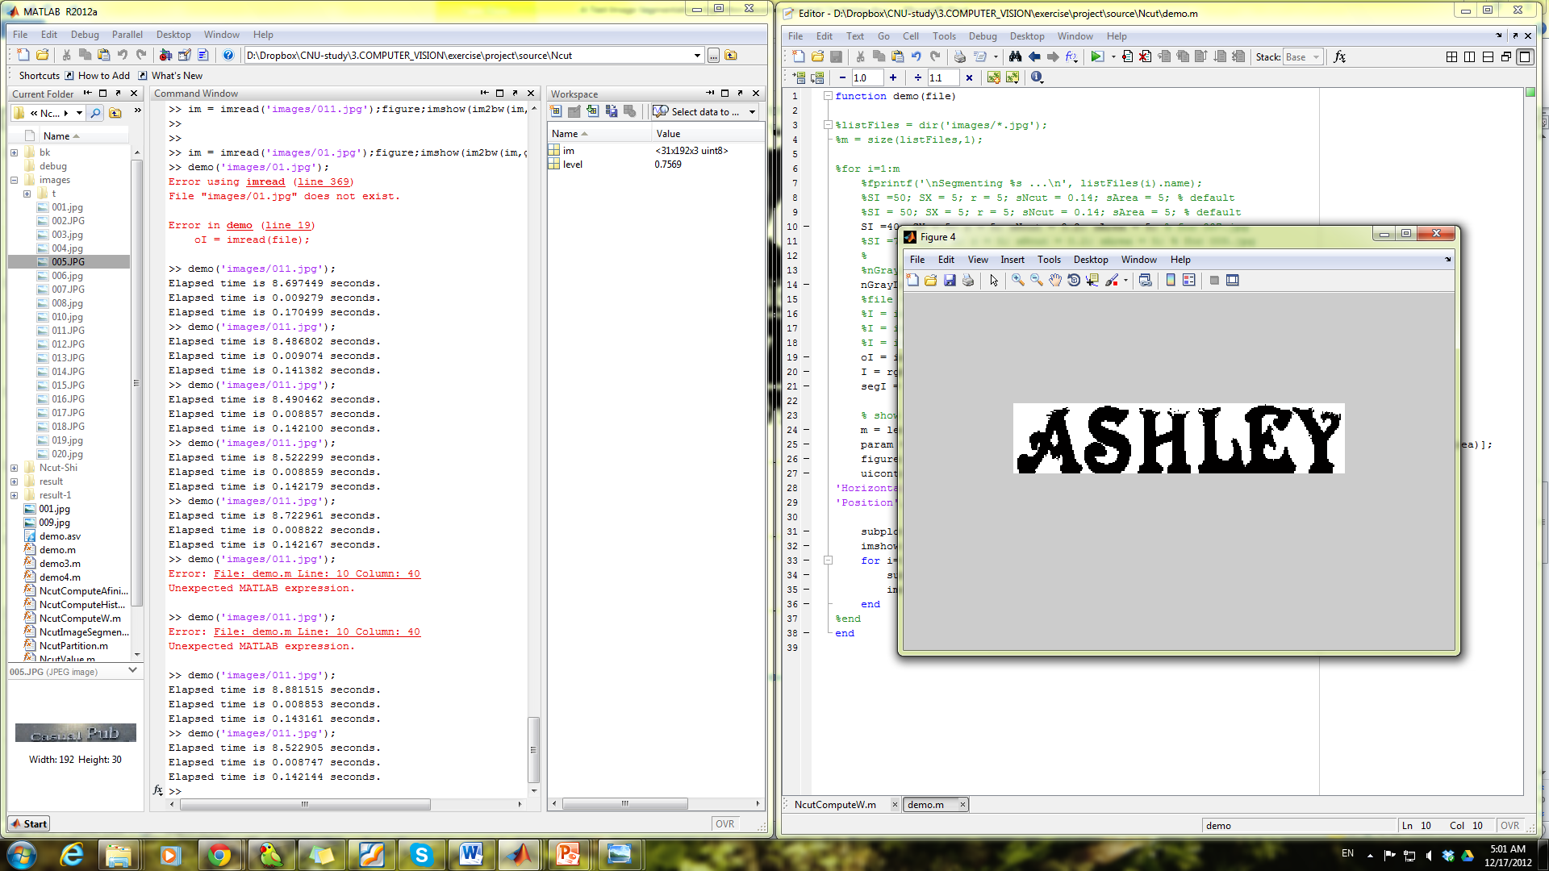
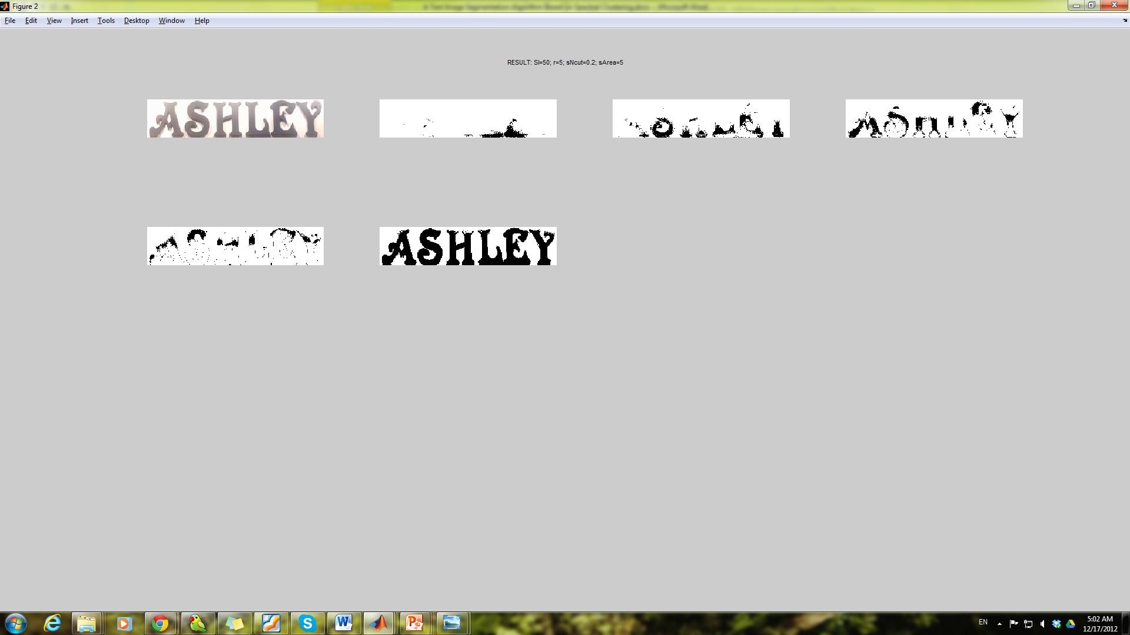
Experimental Result
Original Image
Otsu’s Result
Our result
Normal cases

Slide 15


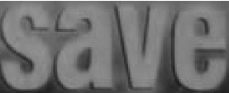




Experimental Result
Original Image
Otsu’s Result
Our result
Normal cases

Slide 16


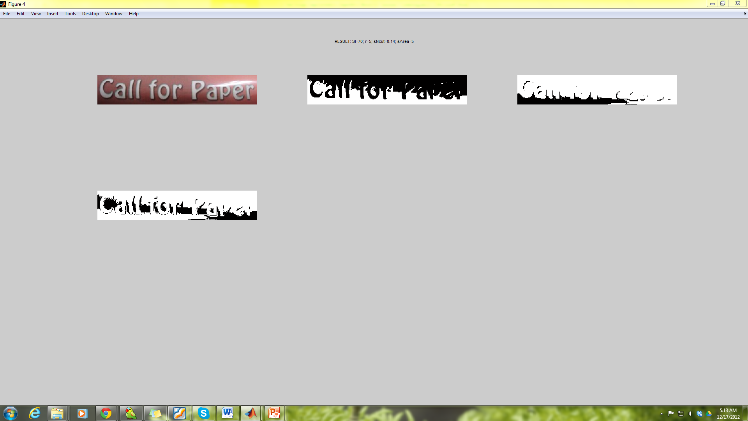

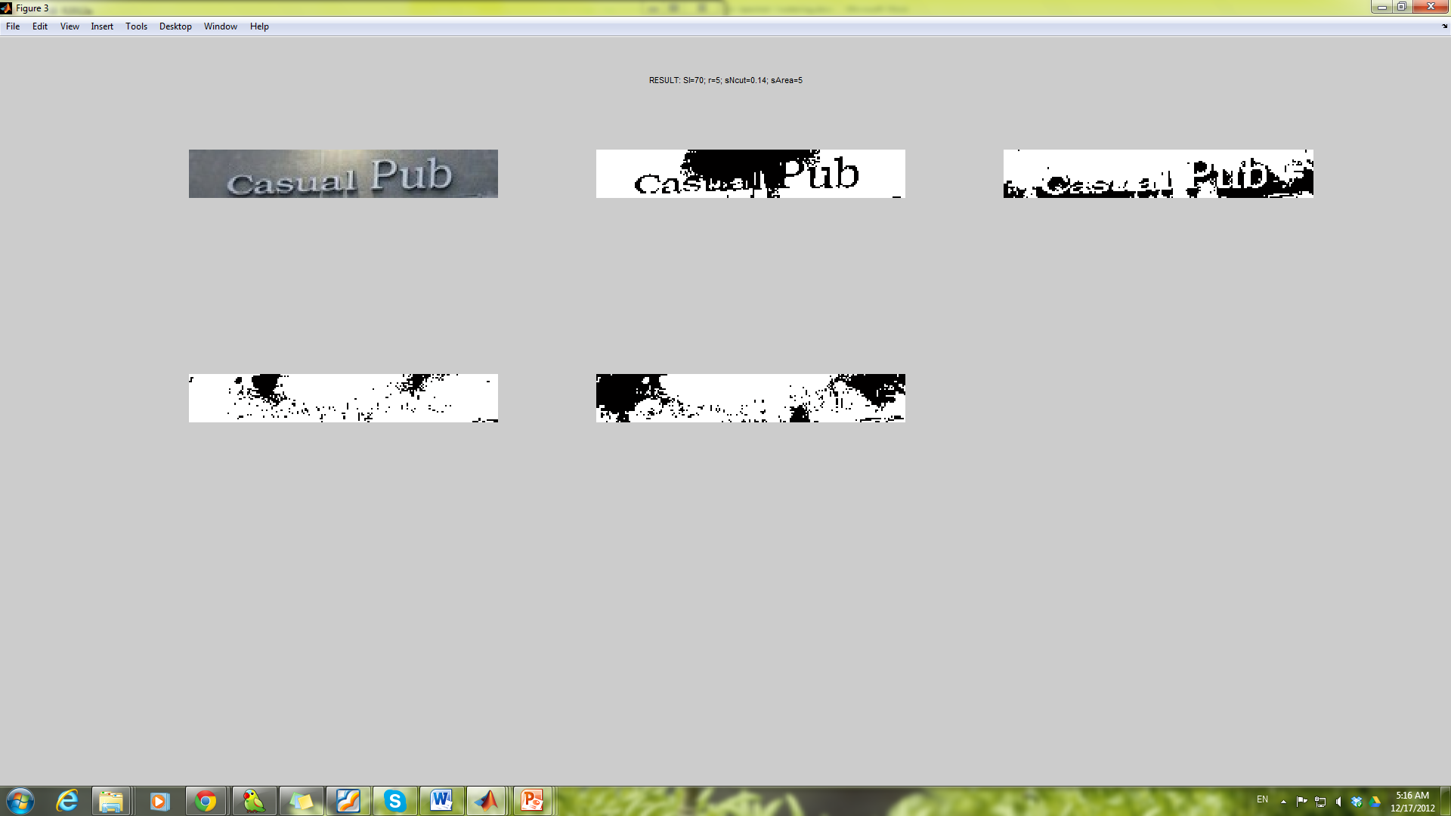
Experimental Result
Original Image
Otsu’s Result
Our result
Abnormal cases

Slide 17
Conclusion and Future work
Thresholding methods are very popular but they cannot work well for image with complex background.
Spectral clustering can resolve the issue by using spectral graph theory
Proposed method controls the complexity of algorithm effectively
Future work:
Post-processing to remove noise and normalize text object.
Try to use rgb information instead of gray-scale level for this method

Slide 18
Reference
R. Wu, J. Huang, X. Tang, and J. Liu, "A Text Image Segmentation Method Based on Spectral Clustering", Computer and Information Science, 2008
Jianbo Shi and Jitendra Malik.(2000) “Normalized Cuts and Image Segmentation.” IEEE Transactions on Pattern Analysis and Machine Intelligence
Lienhart R and Wernicke A.(2002) “Localizing and Segmenting Text in Images and Videos.” IEEE Transaction on Circuits and Systems for Video Technology

Slide 19
Thank you for your attention

